Slide 1
ARE CLOUDS FRACTAL?
ANSEL ONG MING JIN
Notes:
*Not read, just written to organise thoughts*
Good afternoon everyone, my name is Ansel and I’ll be presenting a project titled “Are Clouds Fractal?”. Before I answer the question, let me start off by defining key terms and explaining the reasoning behind this project.
Fractals are something I find hard to understand with words alone, so here is a GIF of a famous fractal known as the Koch snowflake. A fractal can be defined as a geometric shape that exhibits similar patterns across different scales. In this case, no matter how much you zoom in on the Koch snowflake, it still looks like the same shape. The image on the right shows how to construct the Koch snowflake. It starts off as an equilateral triangle, and the next step adds a smaller equilateral triangle to each side. This step is repeated infinitely to form a Koch snowflake but only 4 iterations are shown here. Each fractal will have a fractal dimension which is a number that represents how complex the shape is and this one has a value of 1.26.
Clouds, as we all know, are these white or grey masses that you can often see floating in the sky. So when we ask the question “Are clouds fractal?”, we are asking whether different clouds with different sizes have similar appearances. You may be wondering why we should care about whether clouds are fractal or how these 2 things are related.
Firstly, clouds play an important role in the climate of regulating energy in the atmosphere as they can reflect energy from the Sun back into space and trap energy emitted from the Earth’s surface. This effect is quite significant when we consider that clouds cover about 70% of the Earth’s surface at any given time.
However, clouds are poorly represented in many climate models. As clouds are smaller than a typical gridbox in climate models, cloud processes such as the evolution of clouds are not able to be directly simulated but instead represented with numeric approximations. To assess how well climate models represent clouds, we can calculate the fractal dimensions of cloud fields simulated by climate models and compare them to cloud fields captured by satellites.
Many previous studies have calculated the fractal dimension of clouds when seen from a top down view using a geostationary satellite. A geostationary satellite orbits the Earth at the same speed as its rotation so it remains fixed above a certain point. The goal of this project is to determine whether clouds are fractal based on vertical cross-sections of clouds. To get the vertical cross-section of clouds, we can use data from a vertically pointing radar. As the cloud passes over the radar, radio waves are sent and reflected back to create an image of the vertical cross section which looks similar to a side view.
In 2 dimensional space, the fractal dimension usually varies between 1 and 2, with a greater value indicating a greater complexity. There are many methods to compute the fractal dimension, but the one used in this project is the area-perimeter relation. We use the equation perimeter is directly proportional to area to the power of the fractal dimension divided by 2. To calculate the fractal dimension of clouds, we plot a graph of log p against log a and get the linear fit. The fractal dimension will be the gradient of the line multiplied by 2.
This is an example of the images I processed to get the area and perimeter of clouds. The clouds that I want to select are these ice clouds which are represented in grey. I used OpenCV to extract the ice clouds and drew a green contour around it for visualisation. There are certain cases where there were clouds I could not use in my calculation of the fractal dimension. In the first case, I removed the precipitating clouds, which are outlined in red, from my list of clouds as the precipitation gives the cloud a flatter bottom which significantly lowers the fractal dimension due to the smaller perimeter. In the second case, I noticed random streaks that appeared due to the interruption of the radar beam which caused some clouds to be split into multiple blobs with smooth edges. These also had to be removed due to their smaller perimeter. In the third case, I removed clouds that were too small in area as the lower resolution will give an inaccurate fractal dimension.
There is one more step that needs to be done before the fractal dimension can be calculated, and that is to convert the horizontal time axis to distance. To do this, I used the ERA5 dataset which contains the values of wind speeds at every hour and every model level. Model level refers to different layers of the atmosphere and the height of a model level depends on the pressure. Clouds that span many hours and model levels will have different wind speeds in different sections of the cloud. For example, the top of a cloud could be experiencing a greater wind speed compared to the bottom. For the simplest calculation, I chose to average all the values of wind speeds. After that, we can finally get the area and perimeter of the cloud in kilometres.
Finally, after plotting the data of thousands of clouds, we can get this graph of log p against log a. As the perimeter and area are related by the fractal scaling law, it can be concluded that clouds are indeed fractal. Thank you for listening to my presentation, are there any questions?

Slide 2
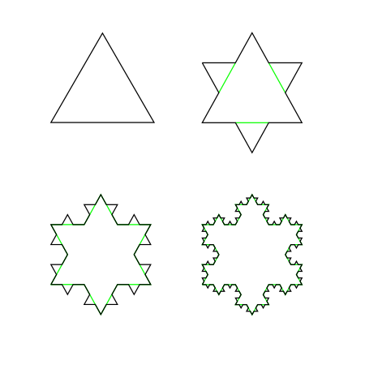
Fractals
Fractal Dimension = 1.26
Zooming into a Koch snowflake
Creating a Koch snowflake

Slide 3

Similar appearance?

Slide 4
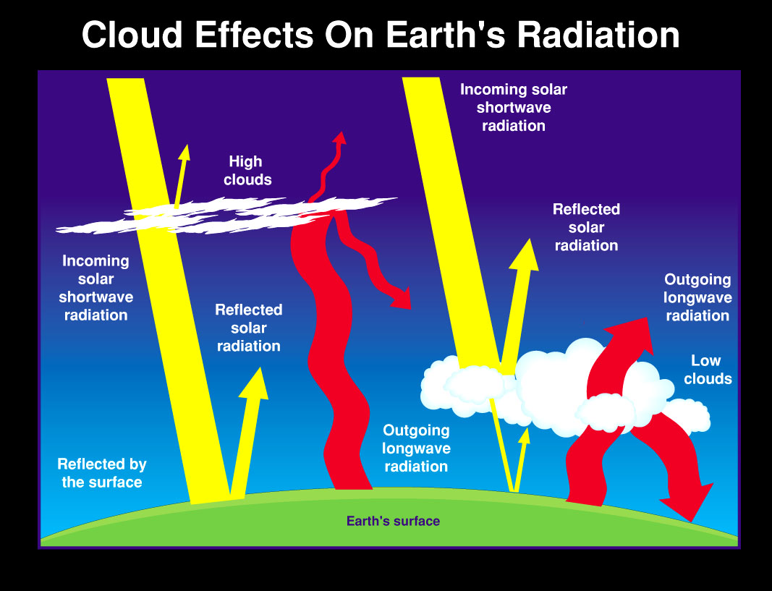

Slide 5
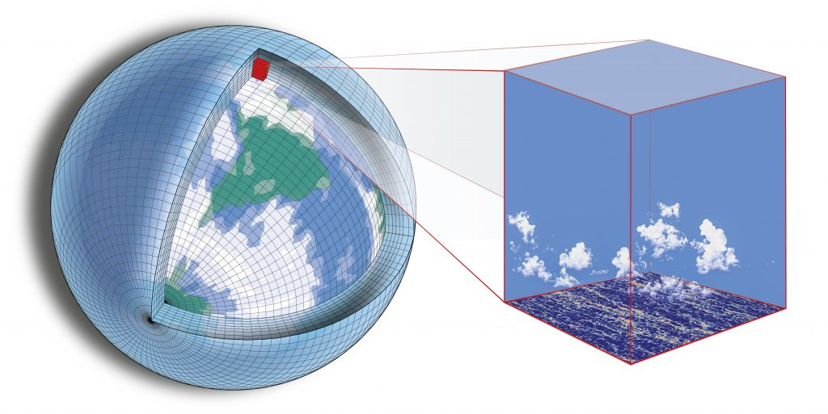
Poor representation of clouds in climate models

Slide 6
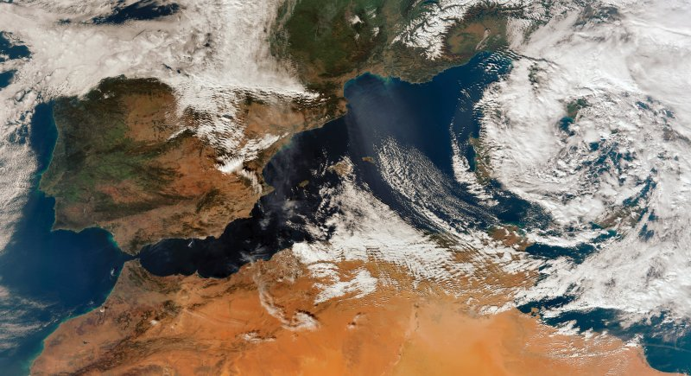
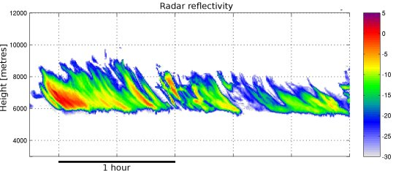
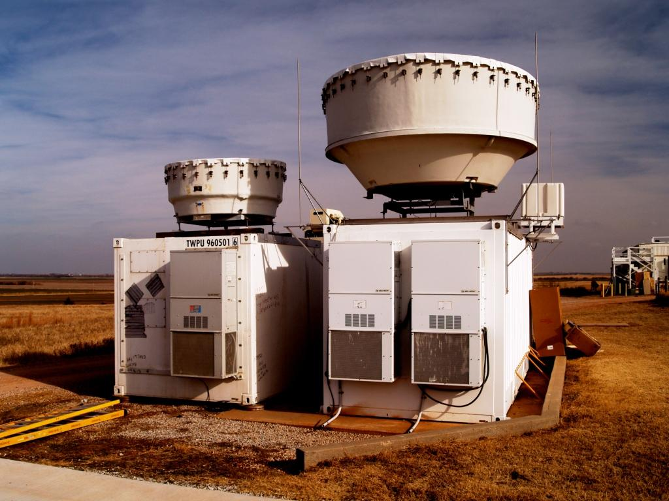
Geostationary satellite
Vertically pointing radar
Radar data
Satellite image
Top down view
Side view

Slide 7
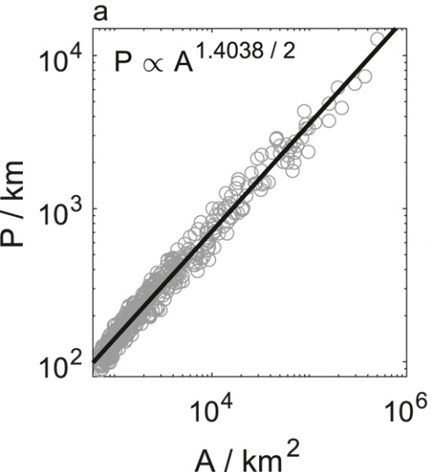
Area-perimeter relation
P ∝ A^{D/2}
Christensen, H. M., & Driver, O. G. A. (2021). The fractal nature of clouds in global storm-resolving models. Geophysical Research Letters, 48, e2021GL095746. https://doi.org/10.1029/2021GL095746

Slide 8
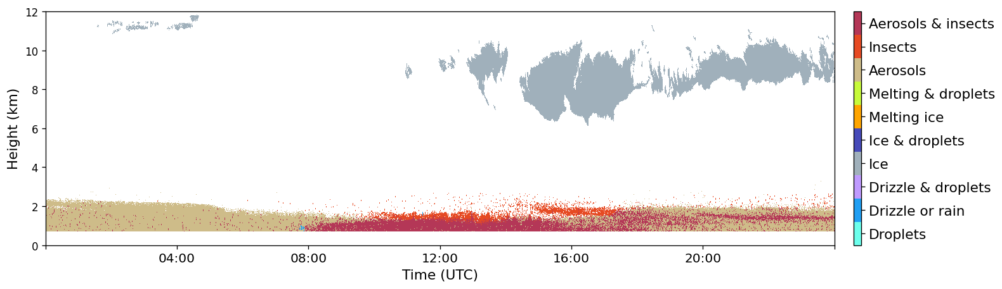

Slide 9
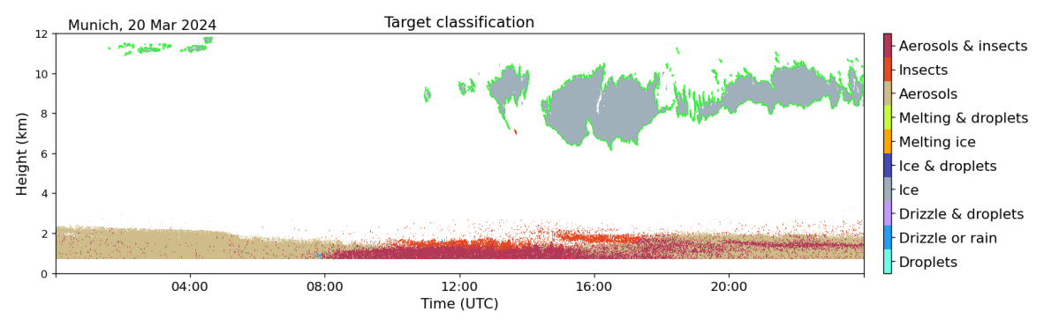

Slide 10
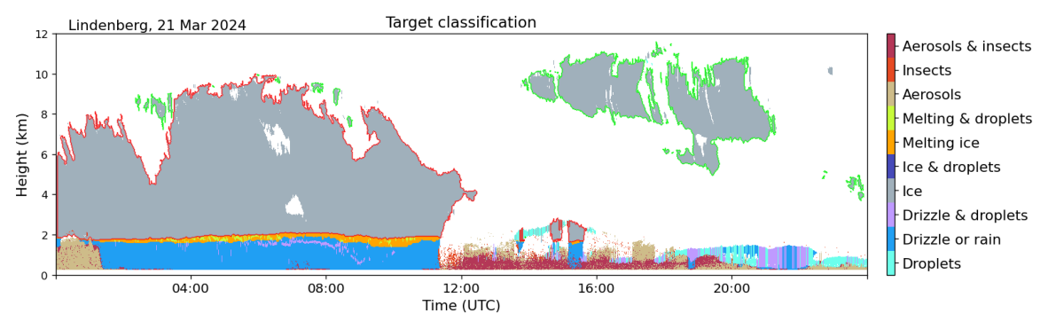
Case #1

Slide 11
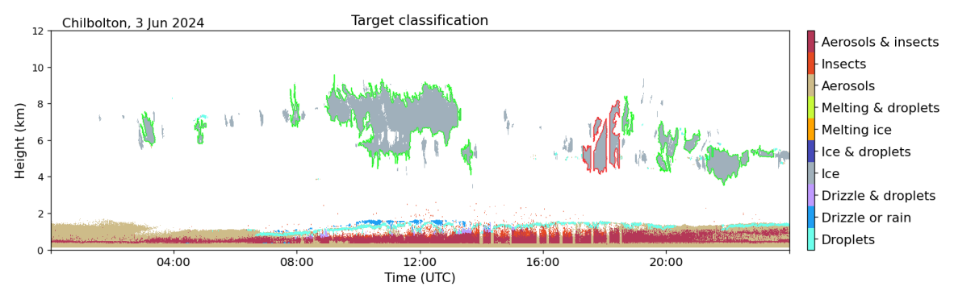
Case #2

Slide 12
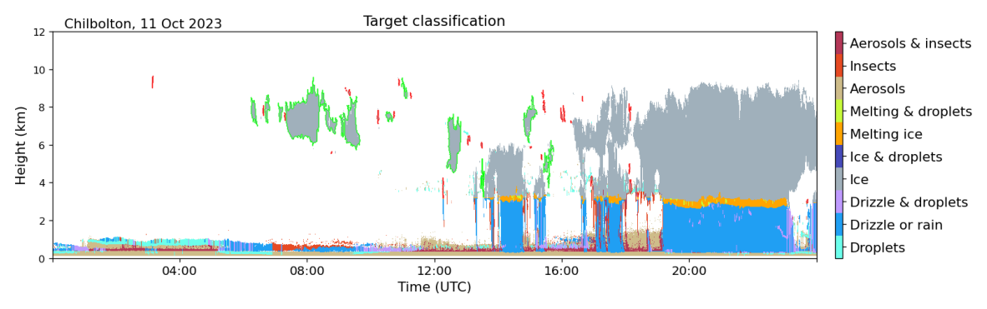
Case #3

Slide 13
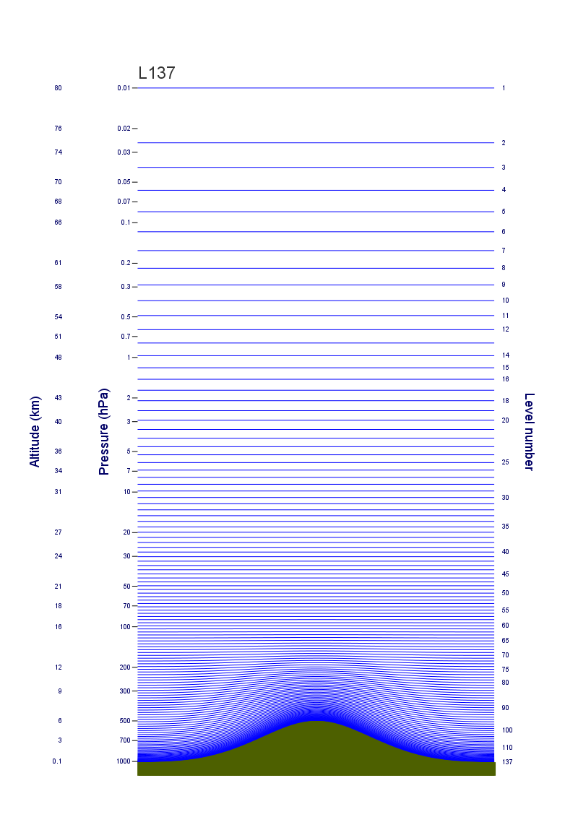
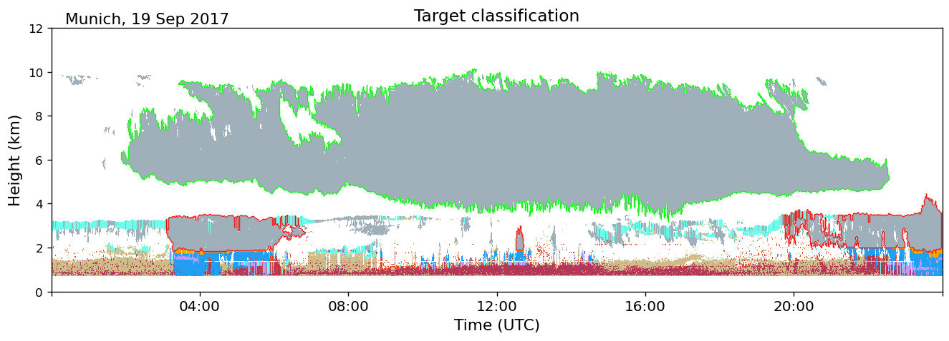
Time to Distance
Model levels

Slide 14
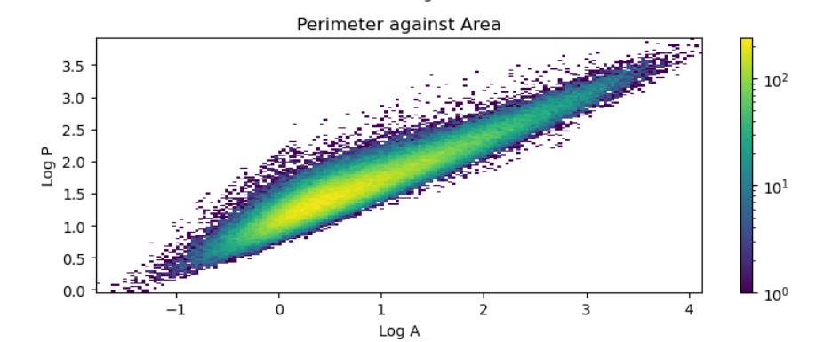
Are Clouds Fractal?
Fractal Scaling Law: P ∝ A^{D/2}

